Slide 1
Architectural and Design Patterns
CS577b
Nupul Kukreja

Slide 2
Agenda
Polymorphism in OOP
Design Patterns
Observer
Singleton
Factory Method
Dependency Injection (Inversion of Control)
Model-View-Controller (MVC)
Architecture-level Patterns
Object Relational Mapping
Active Record
Data Mapper

Slide 3
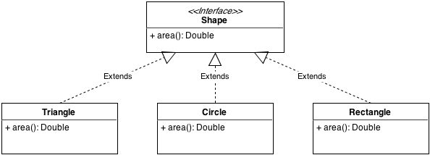
Polymorphism
Definition: “poly” – many, “morph” – form. That is, an object that can take many forms.
Example:
Common interface ‘Shape’ having method area
Each object implements area() differently

Slide 4
Polymorphism in Action
public static void main(String[] args)
{
Shape s; //declare reference of type Shape
s = new Triangle(); //point to a Triangle object
s.area(); //compute area of triangle
s = new Circle(); //point to a Circle object
s.area(); //compute area of circle
s = new Rectangle(); //point to a Rectangle object
s.area(); //compute area of rectangle
}

Slide 5
Polymorphism - Importance
Ability to have same interface but different underlying ‘forms’
Can use any ‘sub-class’ that implements the particular interface
Loose coupling – only talk to the ‘Base class’ (or interface) and not directly to sub-classes (a.k.a. program to interface/supertype)
Disadvantage: sometimes difficult to know which concrete class object is being used (breaks encapsulation/abstraction)
A LOT of design patterns are based on concept of polymorphism

Slide 6
Design Pattern*
A general reusable solution to a commonly occurring (software) design problem
A description/template of how to solve a particular problem that can be used in many different situations
OO design patterns show relationships and interactions between classes/objects (doesn’t specify the actual classes/objects involved)
*http://en.wikipedia.org/wiki/Software_design_pattern

Slide 7
Architectural Patterns
Larger in scope than design patterns
Usually describe an overall pattern followed by entire system
Deep
Domain-Specific
Software Architectures
Architectural
Patterns
Application Domain
Knowledge
Styles
(Program)
Design
Patterns
Shallow
Scope
Programming
(language
level)
Application
Structure
System
Structure

Slide 8
Design Patterns

Slide 9
Observer
Problem: Certain objects need to be informed of a change of state in certain (other) objects
Example(s): Notifications ☺
Facebook notifications
Email notifications (on cell phone) etc.,
The object being observed for changes is commonly referred as “Subject” (or “Observable” in Java parlance)

Slide 10
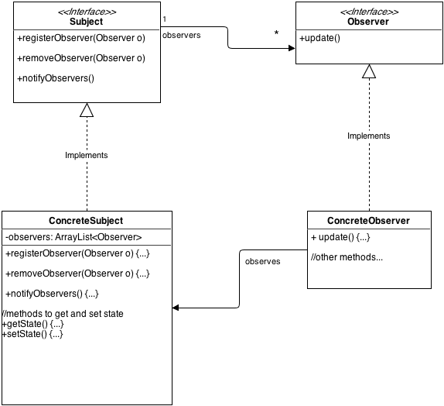
Notes:
Sample code can be found at: https://compilr.com/nupul/classtest/Program.java

Slide 11
Singleton
Problem: Only a single instance of an object is required
Example:
Connection Pool (a pool of connections to be reused; however only need a single pool)
Cache (i.e. reference to single cache)
System Logger
Constrained Resources (e.g. one printer, single board game instance etc.)

Slide 12
Singleton
public class Singleton {
private static Singleton instance; | //hold instance of Singleton
private Singleton(); | //private constructor. Only Singleton can //instantiate itself
public static Singleton getInstance(){ if(instance == null) { instance = new Singleton(); } return instance; } | /** If Singleton is not instantiated, create a new instance and return it **/
//other methods… }
Usage: Singleton.getInstance(); | //Will return single instance every time this //method is called

Slide 13
Singleton – Caveats
Technique on previous slide NOT thread safe!
Use of double-checked locking or static blocks or making them as ‘enum’ (in Java)
It can hide coupling (i.e. different parts of code depend on Singleton but is not directly visible)
Is similar to a global variable in essence – think if you really need it

Slide 14
Factory Method Pattern
Problem: Different types of objects need to be created depending on context. But object creation shouldn’t be muddled with its usage in composing object
Example:
if(type==“sedan”) car = new Sedan();
else if(type==“bug”) car = new Bug();
else if(type==“van”) car = new VWVan();
else if(type==“luxury”) car = new Limo();
//later do something with created ‘car’

Slide 15
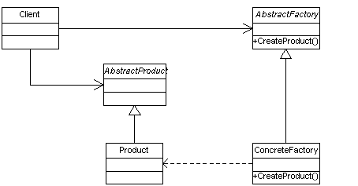
Factory Method Pattern
Defines interface for creating an object but defers instantiation to sub-classes

Slide 16
Factory Method
public abstract class AbstractCarFactory { private Car car;
public bookCar(String type){ | //type of car to book
car = reserveCar(type); //do something with car… } | //call reserveCar to make //reservation
public abstract Car reserveCar (type); } | //abstract – corresponding sub-class //responsible for reserving //particular car
public class Enterprise extends AbstractCarFactory{
public Car reserveCar(String type){ if(type==“sedan”) return new Sedan(); else if(type==“bug”) return new Bug(); else if(type==“van”) return new VWVan(); else if(type==“luxury”) return new Limo(); } } | //override abstract method to //return corresponding type of car
Notes:
It’s not always a method to be overridden by sub-class. Can also be a static method to a factory class to return type of object

Slide 17
Factory Method
Need not be a sub-class method
Can also be a static ‘create’ method in a separate factory class:
CarFactory.getCar(type)
The factory is queried to get/create particular type of object
Multiple dependencies on factory – can lead to coupling (i.e., everybody calling the factory for object instantiation) but is not a ‘bad’ coupling per se

Slide 18
‘new’ is Bad
Shape s = new Triangle();
What if you wish to change implementation of Triangle to EnhancedTriangle?
Change declaration of ‘new Triangle()’ to ‘new EnhancedTriangle()’ everywhere
‘new’ → coupling but new is necessary!!
(Chicken-n-egg problem)
Factories decrease problem to some extent – object creation isolated in factories

Slide 19
Dependency Injection (DI)
A 25-dollar term for a 5-cent concept…it means giving an object its instance variables. Really. That's it.
-James Shore
Basically providing the objects that an object needs instead of constructing them itself
Great for testing – replace with a mockup/stub at any time!
Reduces coupling – swap different version of object by changing a single line in code
Usually handled by frameworks like Spring (Java)

Slide 20
DI - Example
Factory Based Object Creation | DI Based Object Creation
public class MyClass{ public MyClass(){ myObject = Factory.getObject(); } } | public class MyClass{ public MyClass(MyObject obj){ myObject = obj; } }
MyClass responsible for object creation i.e., dependent on Factory for object creation | MyClass provided object via ‘constructor injection’ (can also be via a setter method) public class MyFramework{ public static void main(String[] args){ MyOjbect myObj = new MyObject(); MyClass myClass = new MyClass(myObj) } } Usually done in a configuration file – no recompilation needed!

Slide 21
Model – View – Controller (MVC)
Model
Encapsulates application state
Responds to state queries
Exposes application functionality
Notifies view of changes
State query
State change
Change Notification
View
Renders the models
Request updates from models
Sends user gestures to controller
Allows controller to select view
View Selection
Controller
Defines application behaviour
Maps user actions to model updates
Selects view for response
One for each functionality
User Gestures
Method Invocations
Events (Observer)
Notes:
http://pl.cs.jhu.edu/oose/lectures/images/Figure1.gif

Slide 22
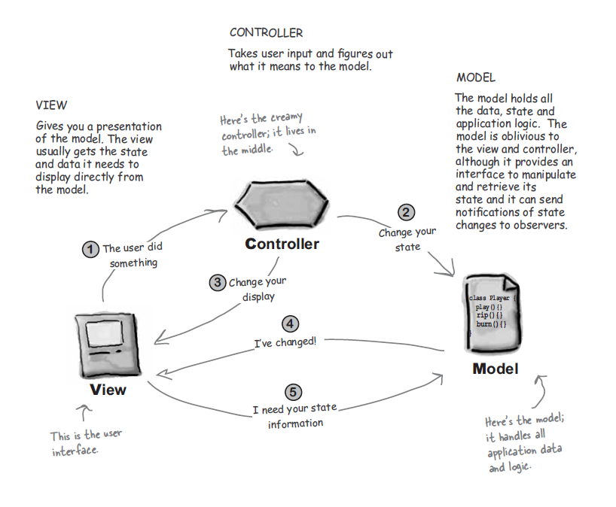
Source: Head First Design Patterns (O’Reilly)

Slide 23
MVC - Advantages
Separation of concerns i.e., loose coupling
Model can change independently of view (and vice versa)
View behavior can be changed by swapping in another controller
Model notifies view of any changes (Observer) for view to update itself
Different views can be created for the same model
Desktop version vs. Mobile version of same data

Slide 24
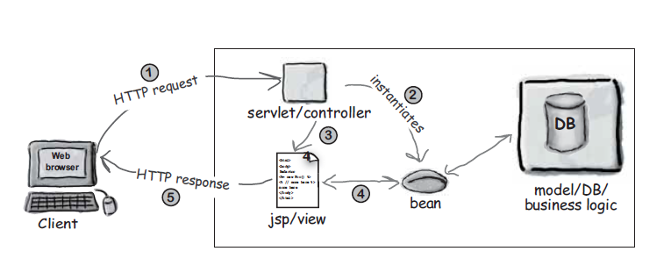
MVC and the Web
Model2 (or MVC2) pioneered by Sun for Java Web Applications
Not MVC per se (but follows similar separation of concerns and hence the confusion)
Diagram Source: Head First Design Patterns (O’Reilly)

Slide 25
Architectural Patterns
(Based on Patterns of Enterprise Application Architecture – M. Fowler)

Slide 26
Object Relational Mapping
Relational Data Stores predominant form of persistence
Different paradigms (relational vs. object oriented lead to object-relational mismatch)
Need for ‘intermediate layer’ to map data database tables to in-memory objects
Common issue – mapping inheritance

Slide 27
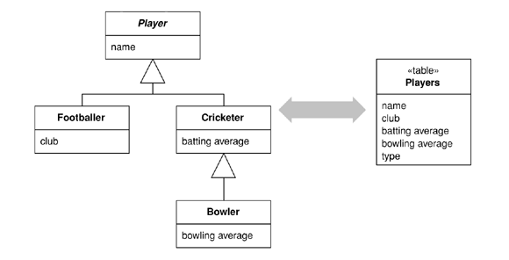
Single Table Inheritance
All classes in hierarchy collapsed into a single table
Tradeoff: Wasted space vs. speed of access (no joins) to load an object

Slide 28
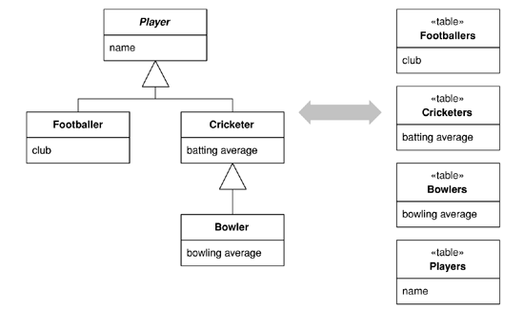
Class Table Inheritance
Table for each class
Tradeoff: low duplication vs. low speed of access (multiple joins)

Slide 29
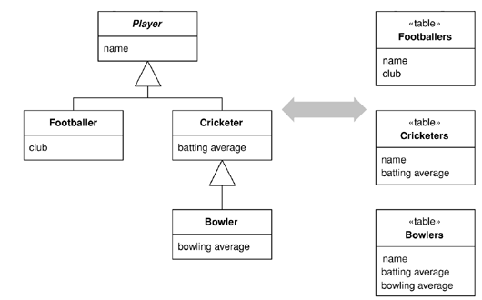
Concrete Table Inheritance
Table for each class
Tradeoff: No join to load object vs. brittle to changes

Slide 30
Object-Relational Mapping Patterns

Slide 31
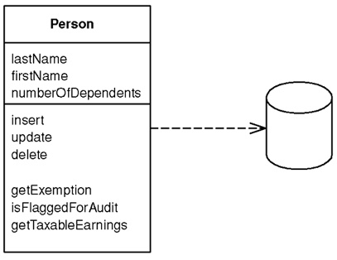
Active Record
An object that wraps a row in a database table or view, encapsulates the database access, and adds domain logic on that data
An object that carries both data and behavior i.e., puts data access behavior in domain object itself

Slide 32
Active Record
The Active Record class typically has methods that do the following:
Construct an instance of the Active Record from a SQL result set row
Construct a new instance for later insertion into the table
Static finder methods to wrap commonly used SQL queries and return Active Record objects
Update the database and insert into it the data in the Active Record
Get and set the fields
Implement some pieces of business logic

Slide 33
Active Record
A good choice for domain logic that isn't too complex, such as creates, reads, updates, and deletes
Simple to build and easy to understand
Works well only if Active Record objects directly correspond to database tables
Couples object design to database design making refactoring difficult
Cumbersome to use in case of complex business logic involving inheritance, relationships, collections etc.,
Ruby’s ActiveRecord made pattern famous – alleviates two primary concerns by adhering to convention:
Single Table Inheritance
Associations declared/fetched using special macros:
belongs_to, has_one, has_many
has_many :through, has_one :through, has_and_belongs_to_many
Notes:
http://guides.rubyonrails.org/association_basics.html

Slide 34
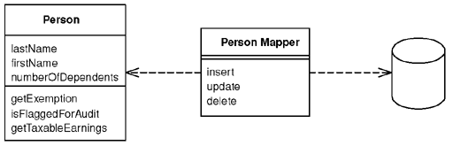
Data Mapper
A layer of mappers that moves data between objects and a database while keeping them independent of each other and the mapper itself
Separates in-memory objects from database
Transfers data between the two and isolates them from each other

Slide 35
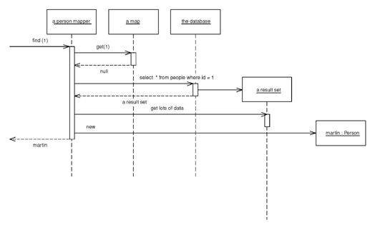
Retrieving data from a database

Slide 36
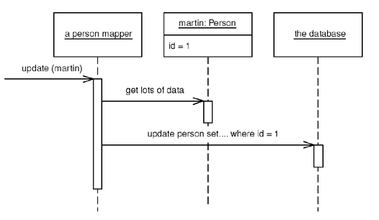
Updating data

Slide 37
Data Mapper
Loose coupling between database schema and object model
Both can evolve independently of each other
Database can be ignored when working on domain model – in development and testing
Adds a layer of complexity (Active Record is simpler)
Data Mapping commonly done with ORM tools like Hibernate, iBatis, Spring JDBC etc.,

Slide 38
Conclusion
Patterns provide solutions to commonly occurring problems
Avoid over-patternization for the sake of it
Skill: To know when not to (and when to) use a pattern
These patterns scratch the surface but are most commonly encountered
Concurrency may be a concern for large scale (web) applications and needs to be handled with appropriate ‘locking’ patterns

Slide 39
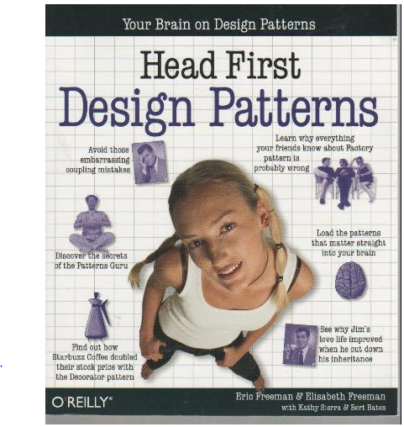
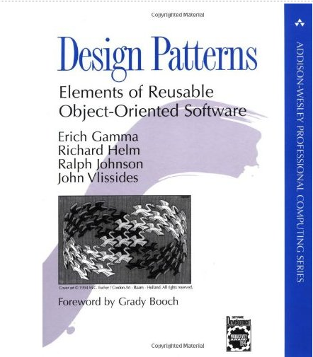
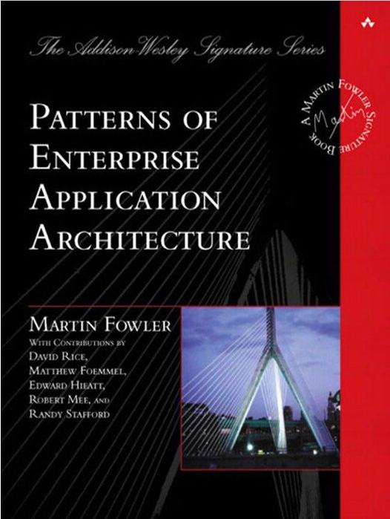
Good Reads

Slide 40
Extras

Slide 41
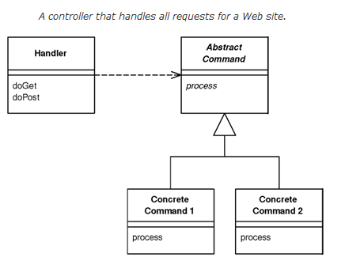
Front Controller

Slide 42
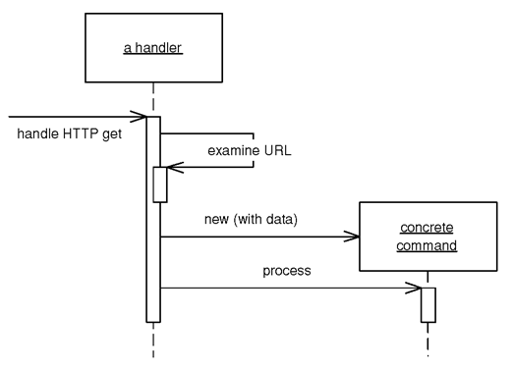
Front Controller

Slide 43
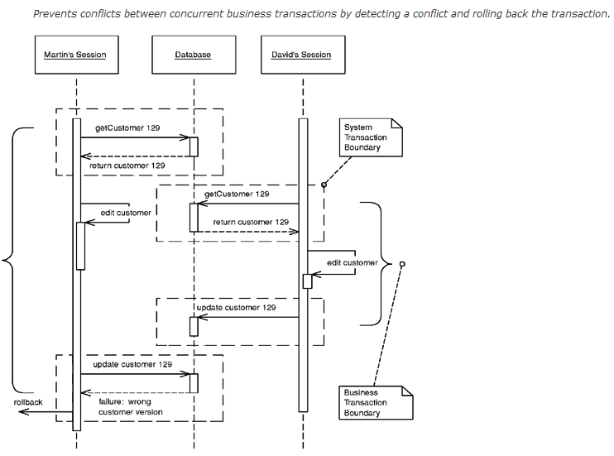
Optimistic Locking

